Slide 1


 | Bhivrabai Sawant Institute of Technology & Research, Gat No. 720/2, Nagar Road, Wagholi, Pune, Maharashtra 412207.
Department Of Computer Engineering

Slide 2

Subject : Data Analytics Subject Code : 410243 Class : BE Computer Engineering Pattern : 2015 Academic Year : 2018-19 Designed By : Prof. Yogendra Patil

Slide 3
Vision & Mission
Institute Vision | "Satisfy the aspirations of youth force, who want to lead nation towards prosperity through techno-economic development.
Institute Mission | To provide, nurture and maintain an environment of high academic excellence, research & entrepreneurship for all aspiring students, which will prepare them to face global challenges maintaining high ethical and moral standards."
Department Vision | Empowering the students to be professionally competent & socially responsible for techno-economic development of society.
Department Mission | To provide quality education enabling students for higher studies, research & entrepreneurship To inculcate professionalism and ethical values through day to day practices.

Slide 4
Objectives and Outcomes
Course Objectives | To develop problem solving abilities using Mathematics To apply algorithmic strategies while solving problems To develop time and space efficient algorithms To study algorithmic examples in distributed, concurrent and parallel environments
Course Outcomes | To write case studies in Business Analytic and Intelligence using mathematical models. To present a survey on applications for Business Analytic and Intelligence. To write problem solutions for multi-core or distributed, concurrent/Parallel environments

Slide 5
Other Information
Teaching Scheme | Lectures: – 3 Hrs/Week
Examination Scheme | In Semester Assessment: 30 End Semester Assessment : 70

Slide 6
UNIT - I
INTRODUCTION AND LIFE CYCLE

Slide 7
Sr.No. |  | Content
Unit - 1. INTRODUCTION AND LIFE CYCLE
1.1 |  | Big data overview
 | 1.1.1 | Data Structures
 | 1.1.2 | Analyst Perspective on Data Repositories
1.2 |  | State of the Practice in Analytics
 | 1.2.1 | Bl Versus Data Science
 | 1.2.2 | Current Analytical Architecture
 | 1.2.3 | Drivers of Big Data
 | 1.2.4 | Emerging Big Data Ecosystem and a New Approach to Analytics
1.3 |  | Data Analytic Life Cycle
 | 1.3.1 | Data Analytics Lifecycle Overview
 | 1.3.2 | phase 1- Discovery
 | 1.3.3 | Phase 2- Data preparation
 | 1.3.4 | Phase 3- Model Planning
 | 1.3.5 | Phase 4- Model Building
 | 1.3.6 | Phase 5- Communicate Results
 | 1.3.7 | Phase 6- Opearationalize
1.4 |  | Case Study: GINA

Slide 8
Unit - 1. INTRODUCTION AND LIFE CYCLE
1.1 |  | Big data overview : Data is created constantly, and at an ever-increasing rate. Mobile phones, social media, imaging technologies to determine a medical diagnosis-all these and more create new data, and that must be stored somewhere for some purpose. Devices and sensors automatically generate diagnostic information that needs to be stored and processed in real time. Three attributes stand out as defining Big Data characteristics: • Huge volume of data • Complexity of data types and structures • Speed of new data creation and growth
 | 1.1.1 | Data Structures : Big data can come in multiple forms, including structured and non-structured data such as financial data, text files, multimedia files, and genetic mappings. Contrary to much of the traditional data analysis performed by organizations, most of the Big Data is unstructured or semi-structured in nature, which requires different techniques and tools to process and analyze.
 | 1.1.2 | Analyst Perspective on Data Repositories : The introduction of spreadsheets enabled business users to create simple logic on data structured in rows and columns and create their own analyses of business problems. Database administrator training is not required to create spreadsheets: They can be set up to do many things quickly and independently of information technology (IT) groups. Spreadsheets are easy to share, and end users have control over the logic involved. However, their proliferation can result in "many versions of the truth."

Slide 9
Unit - 1. INTRODUCTION AND LIFE CYCLE
1.2 |  | State of the Practice in Analytics : Current business problems provide many opportunities for organizations to become more analytical and data driven, as shown in Table-01. Table-01 : Business Drivers for Advanced Analytics Table-01outlines four categories of common business problems that organizations contend with where they have an opportunity to leverage advanced analytics to create competitive advantage. Rather than only performing standard reporting on these areas, organizations can apply advanced analytical techniques to optimize processes and derive more value from these common tasks
 | 1.2.1 | Bl Versus Data Science : Bl tends to provide reports, dashboards, and queries on business questions for the current period or in the past. Bl systems make it easy to answer questions related to quarter-to-date revenue, progress toward quarterly targets, and understand how much of a given product was sold in a prior quarter or year Data Science tends to use disaggregated data in a more forward-looking, exploratory way, focusing on analyzing the present and enabling informed decisions about the future.
Continue…
Business Driver | Examples
Optimize business operations | Sales, pricing, profitability, efficiency
Identify business risk | Customer churn, fraud, default
Predict new business opportunities | Upsell, cross-sell, best new customer prospects
Comply with laws or regulatory requirements | Anti-Money Laundering, Fair Lending, Base l II-III, Sarbanes Oxley (SOX)

Slide 10
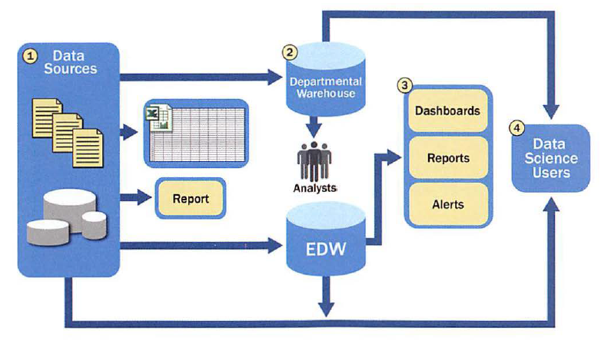
Unit - 1. INTRODUCTION AND LIFE CYCLE
 | 1.2.2 | Current Analytical Architecture : A typical data architecture and several of the challenges it presents to data scientists and others trying to do advanced analytics.
 | 1.2.3 | Drivers of Big Data: The sources of Big Data generated by new applications and the scale and growth rate of the data. These applications, which generate data volumes that can be measured in Exabyte scale, provide opportunities for new analytics and driving new value for organizations.
Continue…
Fig.1. Typical analytic architecture

Slide 11
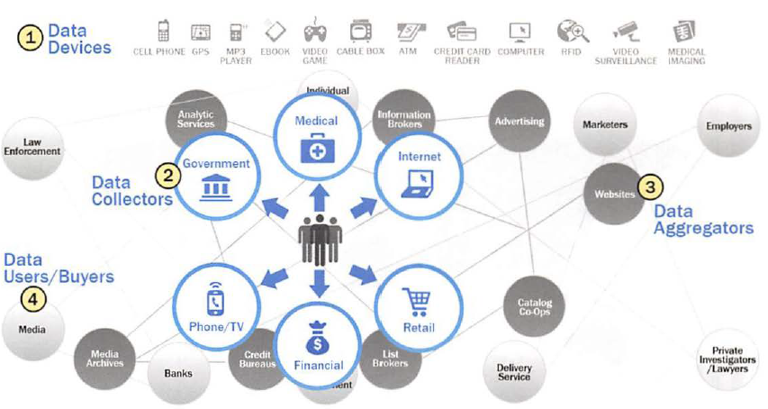
Unit - 1. INTRODUCTION AND LIFE CYCLE
 | 1.2.4 | Emerging Big Data Ecosystem and a New Approach to Analytics : Organizations and data collectors are realizing that the data they can gather from individuals contains intrinsic value and, as a result, a new economy is emerging. As this new digital economy continues to evol ve, the market sees the introduction of data vendors and data cleaners that use crowdsourcing (such as Mechanical Turk and Ga laxyZoo) to test the outcomes of machine learning techniques.
Fig.2 Emerging Big Data ecosystem

Slide 12
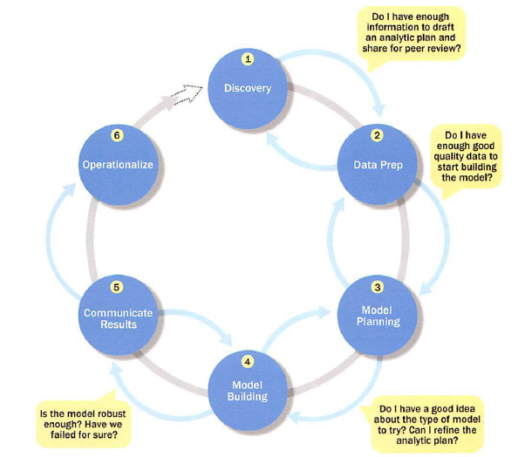
Unit - 1. INTRODUCTION AND LIFE CYCLE
1.3 |  | Data Analytic Life Cycle : Data science projects differ from most traditional Business Intelligence projects and many data analysis projects in that data science projects are more exploratory in nature. The Data Analytics Lifecycle is designed specifically for Big Data problems and data science projects. The lifecycle has six phases.
Continue…
Fig.3 Data Analytic Life Cycle

Slide 13
Unit - 1. INTRODUCTION AND LIFE CYCLE
 | 1.3.1 | Data Analytics Lifecycle Overview : Data Analytics Lifecycle that includes six phases. Teams commonly learn new things in a phase that cause them to go back and refine the work done in prior phases based on new insights and information that have been uncovered
 | 1.3.2 | Phase 1- Discovery: In Phase 1, the team learns the business domain, including relevant history such as whether the organization or business unit has attempted similar projects in the past from which they can learn.
 | 1.3.3 | Phase 2- Data preparation : Phase 2 requires the presence of an analytic sandbox, in which the team can work with data and perform analytics for the duration of the project.
 | 1.3.4 | Phase 3- Model Planning : Phase 3 is model planning, where the team determines the methods, techniques, and workflow it intends to follow for the subsequent model building phase.
 | 1.3.5 | Phase 4- Model Building : In Phase 4, the team develops data sets for testing, training, and production purposes. In addition, in this phase the team builds and executes models based on the work done in the model planning phase.
 | 1.3.6 | Phase 5- Communicate Results : In Phase 5, the team, in collaboration with major stakeholders, determines if the results of the project are a success or a failure based on the criteria developed in Phase 1
 | 1.3.7 | Phase 6- 0perationalize: I n Phase 6, the team delivers final reports, briefings, code, and technical documents. In addition, the team may run a pilot project to implement the models in a production environment.

Slide 14
Unit - 1. INTRODUCTION AND LIFE CYCLE
1.4 |  | Case Study: Global Innovation Network and Analysis (GINA ) EMC's Global Innovation Network and Analytics (GINA) team is a group of senior technologists located in centers of excellence (COEs) around the world. This team's charter is to engage employees across global COEs to drive innovation, research, and university partnerships. The GINA team thought its approach would provide a means to share ideas globally and increase knowledge sharing among GINA members who may be separated geographically. It planned to create a data repository containing both structured and unstructured data to accomplish three main goals. o Store formal and informal data. o Track research from global technologists. o Mine the data for patterns and insights to improve the team's operations and strategy. The GINA case study provides an example of how a team applied the Data Analytics Ufecycle to analyze innovation data at EMC

Slide 15
Unit - 1. INTRODUCTION AND LIFE CYCLE
Summary : Data Analytics Lifecycle, which is an approach to managing and executing analytical projects. This approach describes the process in six phases. 1. Discovery 2. Data preparation 3. Model planning 4. Model building 5. Communicate results 6 . Operationalize Through these steps, data science teams can identify problems and perform rigorous investigation of the datasets needed for in-depth analysis

Slide 16
Unit - 1. INTRODUCTION AND LIFE CYCLE
References Text Book : 1. David Dietrich, Barry Hiller, “Data Science & Big Data Analytics”, EMC education services, Wiley publications, 2012, ISBN 0-07-120413-X

Slide 17
Thank You !

